Slide 1
Chapter 6 Case Studies
Notes:
“Operating Systems: Internal and Design Principles”, 7/e, by William Stallings, Chapter 11 “I/O Management and Disk Scheduling”.

Slide 2
Distributed OS
A distributed operating system is system software over a collection of independent, networked, communicating, and physically separate computational nodes. They handle jobs which are serviced by multiple CPUs.
Multiple central processors are used by Distributed systems to serve multiple real-time applications and multiple users. Accordingly, Data processing jobs are distributed among the processors.
Processors communicate with each other through various communication lines (like high-speed buses or telephone lines). These are known as loosely coupled systems or distributed systems. Processors in this system may vary in size and function. They are referred as sites, nodes, computers, and so on.
Notes:
Perhaps the messiest aspect of operating system design is input/output. Because
there is such a wide variety of devices and applications of those devices, it is difficult
to develop a general, consistent solution.
We begin this chapter with a brief discussion of I/O devices and the organization
of the I/O functions. These topics, which generally come within the scope of
computer architecture, set the stage for an examination of I/O from the point of view
of the operating system.
The next section examines operating system design issues, including design
objectives, and the way in which the I/O function can be structured. Then I/O
buffering is examined; one of the basic I/O services provided by the operating
system is a buffering function, which improves overall performance.
The next sections of the chapter are devoted to magnetic disk I/O. In contemporary
systems, this form of I/O is the most important and is key to the performance as perceived
by the user. We begin by developing a model of disk I/O performance and then
examine several techniques that can be used to enhance performance.
Appendix J summarizes characteristics of secondary storage devices, including
magnetic disk and optical memory.

Slide 3
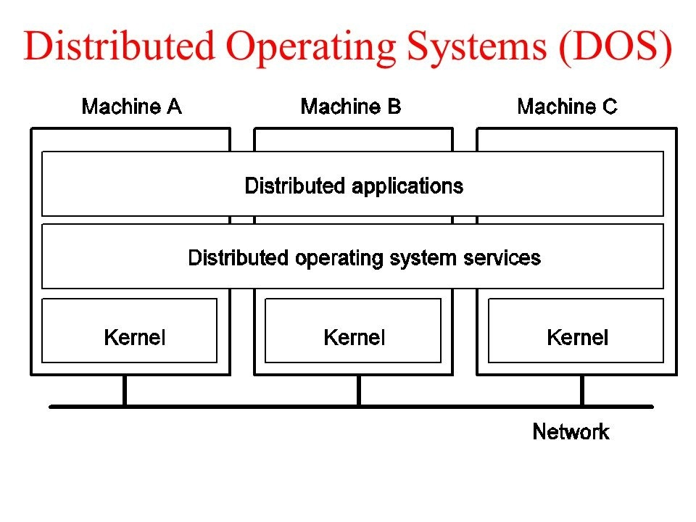
Distributed OS
Notes:
Perhaps the messiest aspect of operating system design is input/output. Because
there is such a wide variety of devices and applications of those devices, it is difficult
to develop a general, consistent solution.
We begin this chapter with a brief discussion of I/O devices and the organization
of the I/O functions. These topics, which generally come within the scope of
computer architecture, set the stage for an examination of I/O from the point of view
of the operating system.
The next section examines operating system design issues, including design
objectives, and the way in which the I/O function can be structured. Then I/O
buffering is examined; one of the basic I/O services provided by the operating
system is a buffering function, which improves overall performance.
The next sections of the chapter are devoted to magnetic disk I/O. In contemporary
systems, this form of I/O is the most important and is key to the performance as perceived
by the user. We begin by developing a model of disk I/O performance and then
examine several techniques that can be used to enhance performance.
Appendix J summarizes characteristics of secondary storage devices, including
magnetic disk and optical memory.

Slide 4
Distributed OS
Advantages
With resource sharing facility, a user at one site may be able to use the resources available at another.
Speedup the exchange of data with one another via electronic mail.
Failure of one site in a distributed system doesn’t affect the others, the remaining sites can potentially continue operating.
Better service to the customers.
Reduction of the load on the host computer.
Reduction of delays in data processing.
Notes:
Perhaps the messiest aspect of operating system design is input/output. Because
there is such a wide variety of devices and applications of those devices, it is difficult
to develop a general, consistent solution.
We begin this chapter with a brief discussion of I/O devices and the organization
of the I/O functions. These topics, which generally come within the scope of
computer architecture, set the stage for an examination of I/O from the point of view
of the operating system.
The next section examines operating system design issues, including design
objectives, and the way in which the I/O function can be structured. Then I/O
buffering is examined; one of the basic I/O services provided by the operating
system is a buffering function, which improves overall performance.
The next sections of the chapter are devoted to magnetic disk I/O. In contemporary
systems, this form of I/O is the most important and is key to the performance as perceived
by the user. We begin by developing a model of disk I/O performance and then
examine several techniques that can be used to enhance performance.
Appendix J summarizes characteristics of secondary storage devices, including
magnetic disk and optical memory.

Slide 5
Real Time OS ( RTOS)
Real time operating systems (RTOS) are used in environments where a large number of events, mostly external to the computer system, must be accepted and processed in a short time or within certain deadlines. such applications are industrial control, telephone switching equipment, flight control, and real time simulations.
The real time operating systems can be of 2 types –
Hard Real Time operating system
Soft real time operating system:
Notes:
Perhaps the messiest aspect of operating system design is input/output. Because
there is such a wide variety of devices and applications of those devices, it is difficult
to develop a general, consistent solution.
We begin this chapter with a brief discussion of I/O devices and the organization
of the I/O functions. These topics, which generally come within the scope of
computer architecture, set the stage for an examination of I/O from the point of view
of the operating system.
The next section examines operating system design issues, including design
objectives, and the way in which the I/O function can be structured. Then I/O
buffering is examined; one of the basic I/O services provided by the operating
system is a buffering function, which improves overall performance.
The next sections of the chapter are devoted to magnetic disk I/O. In contemporary
systems, this form of I/O is the most important and is key to the performance as perceived
by the user. We begin by developing a model of disk I/O performance and then
examine several techniques that can be used to enhance performance.
Appendix J summarizes characteristics of secondary storage devices, including
magnetic disk and optical memory.

Slide 6
Real Time OS ( RTOS)
Hard Real Time operating system: These operating systems guarantee that critical tasks be completed within a range of time.
For example, a robot is hired to weld a car body, if robot welds too early or too late, the car cannot be sold, so it is a hard real time system that require to complete car welding by robot hardly on the time.
Notes:
Perhaps the messiest aspect of operating system design is input/output. Because
there is such a wide variety of devices and applications of those devices, it is difficult
to develop a general, consistent solution.
We begin this chapter with a brief discussion of I/O devices and the organization
of the I/O functions. These topics, which generally come within the scope of
computer architecture, set the stage for an examination of I/O from the point of view
of the operating system.
The next section examines operating system design issues, including design
objectives, and the way in which the I/O function can be structured. Then I/O
buffering is examined; one of the basic I/O services provided by the operating
system is a buffering function, which improves overall performance.
The next sections of the chapter are devoted to magnetic disk I/O. In contemporary
systems, this form of I/O is the most important and is key to the performance as perceived
by the user. We begin by developing a model of disk I/O performance and then
examine several techniques that can be used to enhance performance.
Appendix J summarizes characteristics of secondary storage devices, including
magnetic disk and optical memory.

Slide 7
Real Time OS ( RTOS)
Soft real time operating system: This operating systems provides some relaxation in time limit.
For example – Multimedia systems, digital audio system etc. Explicit, programmer- defined and controlled processes are encountered in real time systems. A separate process is changed with handling a single external event. The process is activated upon occurrence of the related event signaled by an interrupt.
Notes:
Perhaps the messiest aspect of operating system design is input/output. Because
there is such a wide variety of devices and applications of those devices, it is difficult
to develop a general, consistent solution.
We begin this chapter with a brief discussion of I/O devices and the organization
of the I/O functions. These topics, which generally come within the scope of
computer architecture, set the stage for an examination of I/O from the point of view
of the operating system.
The next section examines operating system design issues, including design
objectives, and the way in which the I/O function can be structured. Then I/O
buffering is examined; one of the basic I/O services provided by the operating
system is a buffering function, which improves overall performance.
The next sections of the chapter are devoted to magnetic disk I/O. In contemporary
systems, this form of I/O is the most important and is key to the performance as perceived
by the user. We begin by developing a model of disk I/O performance and then
examine several techniques that can be used to enhance performance.
Appendix J summarizes characteristics of secondary storage devices, including
magnetic disk and optical memory.

Slide 8
Real Time OS ( RTOS)
Multitasking operation is accomplished by scheduling processes for execution independently of each other.
Each process is assigned a certain level of priority that corresponds to the relative importance of the event that it services.
The processor is allocated to the highest priority processes. This type of scheduling, called, priority based preemptive scheduling is used by real time systems.
Notes:
Perhaps the messiest aspect of operating system design is input/output. Because
there is such a wide variety of devices and applications of those devices, it is difficult
to develop a general, consistent solution.
We begin this chapter with a brief discussion of I/O devices and the organization
of the I/O functions. These topics, which generally come within the scope of
computer architecture, set the stage for an examination of I/O from the point of view
of the operating system.
The next section examines operating system design issues, including design
objectives, and the way in which the I/O function can be structured. Then I/O
buffering is examined; one of the basic I/O services provided by the operating
system is a buffering function, which improves overall performance.
The next sections of the chapter are devoted to magnetic disk I/O. In contemporary
systems, this form of I/O is the most important and is key to the performance as perceived
by the user. We begin by developing a model of disk I/O performance and then
examine several techniques that can be used to enhance performance.
Appendix J summarizes characteristics of secondary storage devices, including
magnetic disk and optical memory.

Slide 9
Real Time OS ( RTOS)
Advantages:
Maximum consumption – Maximum utilization of devices and system. Thus more output from all the resources.
Focus On Application – Focus on running applications and less importance to applications which are in queue.
Real Time Operating System In Embedded System – Since size of programs are small, RTOS can also be embedded systems like in transport and others.
Error Free – These types of systems are error free.
Memory Allocation – Memory allocation is best managed in these type of systems.
Notes:
Perhaps the messiest aspect of operating system design is input/output. Because
there is such a wide variety of devices and applications of those devices, it is difficult
to develop a general, consistent solution.
We begin this chapter with a brief discussion of I/O devices and the organization
of the I/O functions. These topics, which generally come within the scope of
computer architecture, set the stage for an examination of I/O from the point of view
of the operating system.
The next section examines operating system design issues, including design
objectives, and the way in which the I/O function can be structured. Then I/O
buffering is examined; one of the basic I/O services provided by the operating
system is a buffering function, which improves overall performance.
The next sections of the chapter are devoted to magnetic disk I/O. In contemporary
systems, this form of I/O is the most important and is key to the performance as perceived
by the user. We begin by developing a model of disk I/O performance and then
examine several techniques that can be used to enhance performance.
Appendix J summarizes characteristics of secondary storage devices, including
magnetic disk and optical memory.

Slide 10
Real Time OS ( RTOS)
Disadvantages:
Limited Tasks – Very few task run at the same time and their concentration is very less on few applications to avoid errors.
Use Heavy System Resources – Sometimes the system resources are not so good and they are expensive as well.
Complex Algorithms – The algorithms are very complex and difficult for the designer to write on.
Device Driver And Interrupt signals – It needs specific device drivers and interrupt signals to response earliest to interrupts.
Notes:
Perhaps the messiest aspect of operating system design is input/output. Because
there is such a wide variety of devices and applications of those devices, it is difficult
to develop a general, consistent solution.
We begin this chapter with a brief discussion of I/O devices and the organization
of the I/O functions. These topics, which generally come within the scope of
computer architecture, set the stage for an examination of I/O from the point of view
of the operating system.
The next section examines operating system design issues, including design
objectives, and the way in which the I/O function can be structured. Then I/O
buffering is examined; one of the basic I/O services provided by the operating
system is a buffering function, which improves overall performance.
The next sections of the chapter are devoted to magnetic disk I/O. In contemporary
systems, this form of I/O is the most important and is key to the performance as perceived
by the user. We begin by developing a model of disk I/O performance and then
examine several techniques that can be used to enhance performance.
Appendix J summarizes characteristics of secondary storage devices, including
magnetic disk and optical memory.

Slide 11
XV6 OS
Xv6 a simple, Unix-like teaching operating system developed in the summer of 2006 by MIT's
Provides the basic interfaces introduced by Ken Thompson and Dennis Ritchie’s Unix operating system, as well as mimicking Unix’s internal design.
Provides Process Management, synchronization, memory management, File Management Functionalities.
Reference- https://pdos.csail.mit.edu/6.828/2012/xv6/book-rev7.pdf
Notes:
Perhaps the messiest aspect of operating system design is input/output. Because
there is such a wide variety of devices and applications of those devices, it is difficult
to develop a general, consistent solution.
We begin this chapter with a brief discussion of I/O devices and the organization
of the I/O functions. These topics, which generally come within the scope of
computer architecture, set the stage for an examination of I/O from the point of view
of the operating system.
The next section examines operating system design issues, including design
objectives, and the way in which the I/O function can be structured. Then I/O
buffering is examined; one of the basic I/O services provided by the operating
system is a buffering function, which improves overall performance.
The next sections of the chapter are devoted to magnetic disk I/O. In contemporary
systems, this form of I/O is the most important and is key to the performance as perceived
by the user. We begin by developing a model of disk I/O performance and then
examine several techniques that can be used to enhance performance.
Appendix J summarizes characteristics of secondary storage devices, including
magnetic disk and optical memory.

Slide 12
Mobile OS
A mobile operating system is an operating system that helps to run other application software on mobile devices. It is the same kind of software as the famous computer operating systems like Linux and Windows, but now they are light and simple to some extent.
The operating systems found on smartphones include Symbian OS, iPhone OS, RIM's BlackBerry, Windows Mobile, Palm WebOS, Android, and Maemo. Android, WebOS, and Maemo are all derived from Linux. The iPhone OS originated from BSD and NeXTSTEP, which are related to Unix.
It combines the beauty of computer and hand use devices. It typically contains a cellular built-in modem and SIM tray for telephony and internet connections. If you buy a mobile, the manufacturer company chooses the OS for that specific device.
Reference-
https://www.ijser.org/researchpaper/A-Study-on-Current-Mobile-Operating-Systems.pdf
Notes:
Perhaps the messiest aspect of operating system design is input/output. Because
there is such a wide variety of devices and applications of those devices, it is difficult
to develop a general, consistent solution.
We begin this chapter with a brief discussion of I/O devices and the organization
of the I/O functions. These topics, which generally come within the scope of
computer architecture, set the stage for an examination of I/O from the point of view
of the operating system.
The next section examines operating system design issues, including design
objectives, and the way in which the I/O function can be structured. Then I/O
buffering is examined; one of the basic I/O services provided by the operating
system is a buffering function, which improves overall performance.
The next sections of the chapter are devoted to magnetic disk I/O. In contemporary
systems, this form of I/O is the most important and is key to the performance as perceived
by the user. We begin by developing a model of disk I/O performance and then
examine several techniques that can be used to enhance performance.
Appendix J summarizes characteristics of secondary storage devices, including
magnetic disk and optical memory.

